Slide 1
ENGL 158: COMMUNICATION SKILLS II
Lecture 9-10: Report Writing

Slide 2
AIMS OF THE LECTURE
The aims of this lecture are as follows:
to introduce students to definition and types of reports
to discuss the importance and structure of reports
to enable students to develop practical skills in report writing

Slide 3
REPORTS
What do you understand by the concept report?

Slide 4
REPORT cont’d
A report in communication register is a detailed written statement, a description or an account of the exercise especially after it is over or completed. At times too, it may mean a detailed and usually formal account of a discussion of investigation and decision of an individual, a panel, a committee or a group of people.
(Adolinama 2005: 334)
A report looks at the past or the present situation in order that one can make a decision for the future. A report is thus an intervention between the present and the future. It is based on an objective position that we cannot make good decisions for the future except that we are adequately informed about the details of how things are, have been, or were.
(Sekyi-Baidoo 2003:256)

Slide 5
REPORT cont’d
Report writing focuses on adequately answering reader’s questions such as what happened, where, why, when and how it happened.
A report looks at the past or the present situation in order that one can make a decision for the future.
Therefore, we make decisions based on the information we have at our disposal.
An informed account of a situation which helps us to know and to take decisions is what we refer to in the formal context as a REPORT.

Slide 6
WHY DO WE WRITE REPORTS?
Report writing aims to serve the following:
To explain:
A report serves to explain explicitly to its readers what happened and why it happened.
The main aim of report writing in this case is to explain events from all angles and provide interpretations so that the reader can understand all its ramifications.
It attempts to provide the basis for, and examines the underlying causes of, people’s actions and the possible consequences of such actions.
To inform:
This implies that you unfold the sequence of events for the purpose of acquainting your reader with the order in which these events occur.
- The reader after reading the report should know exactly when an event began, what happened as it unfolded, at what points the relevant happenings occurred, and how it all ended.

Slide 7
SOME THINGS TO NOTE IN REPORT WRITING
The process of writing a report consists of three activities:
Researching – looking for facts: (e.g. obtaining relevant and adequate data or information about the problem or the subject matter; identifying the sources of information; etc.)
Analysis and interpretation of information: (e.g. breaking up the data obtained and making accurate meaning out of it; relating the data to the problem, etc.)
Presentation of analysed facts: (e.g. presenting the outcome of the data analysis and interpretation; communicating the conclusions and suggestions obtained from the data, etc.)
Notes:
The process of writing consist of three activities;
Researching – looking for facts: This includes obtaining relevant and adequate data or information about the problem or the subject matter; identifying the sources of information; adopting appropriate data collection techniques (e.g. interviews, questionnaires, etc.); obtaining reliable and a well represented data, etc.
Analysis and interpretation of information: This includes breaking up the data obtained and making accurate meaning out of it; relating the data to the problem; employing multiple resources for the analysis and interpretation of the data, etc.
Presentation of analysed facts: This includes presenting the outcome of the data analysis and interpretation; communicating the conclusions and suggestions obtained from the data, reporting on the observations from the research, etc.

Slide 8
TYPES OF REPORTS
Long Report (e.g. academic report, general report, financial report, scholastic report)
Short Report (Mainly noted for its conciseness and brevity, and thus can be seen as a compressed form of the long report. It usually represents a lower level of formality than the long report.)
Letter Report (A formal letter that is usually personal and uses the personal pronouns ‘I’ and ‘we’. This is because it somehow directly communicates the speech of the investigator, who writes his/her signature and name in the subscription)
Memorandum Report (Generally an informal communication about a particular matter)
Any other written piece that gives an account of what has happened in our daily living.

Slide 9
SOME SPECIFIC TYPES OF REPORTS
Attachment reports
Lab reports
Project reports/End of project reports
Steward reports (SONAs, VC’s reports, Headmaster’s report, etc.)
Etc.

Slide 10
STRUCTURE OF A REPORT
Though there are different forms of report, it is important to note that almost every report has the structure below:
Title
The Introduction
The Main Body
The Ending of the Report
Formal report may also have the structure below:
Title
Terms of Reference or Introduction
Procedure or Method
Findings/Content
Conclusions
Recommendations
References/Bibliography/Appendix

Slide 11
FEATURES OF A GOOD REPORT
A good report must have the following characteristics:
It must be based on a well-researched and analysed data.
It should be focused on the problem and need at stake, and must help in resolving them.
It must be presented in the recommended or effective style.

Slide 12
EXECUTIVE SUMMARY & TABLE OF CONTENTS
Executive summary: This is an end-summary, however, it appears to be much more detailed and covers a wider scope. It summarises the main data and presents the conclusions and recommendations. It is direct, concise and poised in its presentation. It is also called symposia.
Executive summary serves three major functions:
- It helps those who may be too busy to read the whole report.
- It prepares the reader’s mind to what the whole report contains. It diffuses the tension associated with having to read the whole report before knowing what it contains.
- It can also be seen as a source of revision for those who have already read the report.
Table of contents: It provides a list of the various aspects of the report and their corresponding pages. It also lists the various figures in the report and where they can be found.

Slide 13
LETTER OF AUTHORIZATION & LETTER OF TRANSMITTAL
Letter of authorization: This is usually a copy of the letter that authorised the investigator to carry out the study. Such a letter reminds the recipient that the report comes in response to this request. The letter usually contains the following:
- the problem
- the purpose of investigation
- suggested methodology for the investigation, analysis and presentation, and the terms of reference
- a statement of authorisation
Letter of Transmittal/Letter of submission: This is a document that formally transmits the report to the recipient, and may refer to the problem and the authorisation. It thus serves to hand over the report, and sometimes carries a summary of the findings or recommendations and also provides information which explains the presentation, nature and use of the report.

Slide 14
PRACTICAL SESSION
Discussion of a sample letter of authorisation and letter of transmittal

Slide 15
PRACTICAL SESSION: A sample letter of authorisation
How to write any authorization letter:
Identify yourself as accurately as possible.
Introduce the person or entity to whom you wish to grant authority.
Mention their name, their ID number, and how they relate to you.
Specify the scope of the authority, that is the allowed actions.
Specify any exclusions if any. These are specific actions within the scope that you explicitly do not wish to authorize.
Provide a starting and an expiry date if needed.
List additional clauses as needed, for example, the transferable authority clause.
(http://www.lettersandtemplates.com/simple-authorization-letter-sample)

Slide 16
PRACTICAL SESSION: A sample letter of authorisation
[Your Name] [Your Address] [Your Contact Information] [Date]
[Recipient Name] [Recipient Address]
Authorization Letter
I, [your name], hereby authorize [Mr. John Smith] to [authorization actions, example: sell my car, sell my house, withdraw money from my bank account number xxxxxx, etc.….] excluding [excluded actions, specific things that you don’t want to authorize] starting from [start date] till [end date or empty].
[Mr. John] may sign all necessary documents and perform related actions within the scope described in this letter.
The authorized person’s identity proof details and signature are provided below for your reference and verification purposes.
Authorized Person: [Mr. John Smith] Identity Document: [Passport] Identity Document Number: [123456789] Authorized Person’s Signature: Authorized Transactions: [withdrawals, deposits, loan settlements, etc.….] Unauthorized Transactions: [fixed deposits, etc.…] Start Date: [start date] End Date: [end date]
Sincerely,
[Signature]
[Name}
(http://www.lettersandtemplates.com/simple-authorization-letter-sample)

Slide 17
PRACTICAL SESSION: A letter of transmittal
Some Tips on How to Write Transmittal Letters:
Include heading with the date and the address of the recipient.
Greet the recipient appropriately
Write the body of the letter
Mention the purpose of the letter
Request for follow-up or further instructions
Provide details about document that is attached
Include a short closing paragraph
Make sure whatever you have written is clear and accessible. Make sure you are concise. Use a tone that is friendly in nature. You should always accompany the documentation that you intend on introducing.
Always keep a copy of the letter of transmittal and all sorts of documentation for your own records. Etc.
(https://www.aplustopper.com/letter-of-transmittal-samples/)

Slide 18
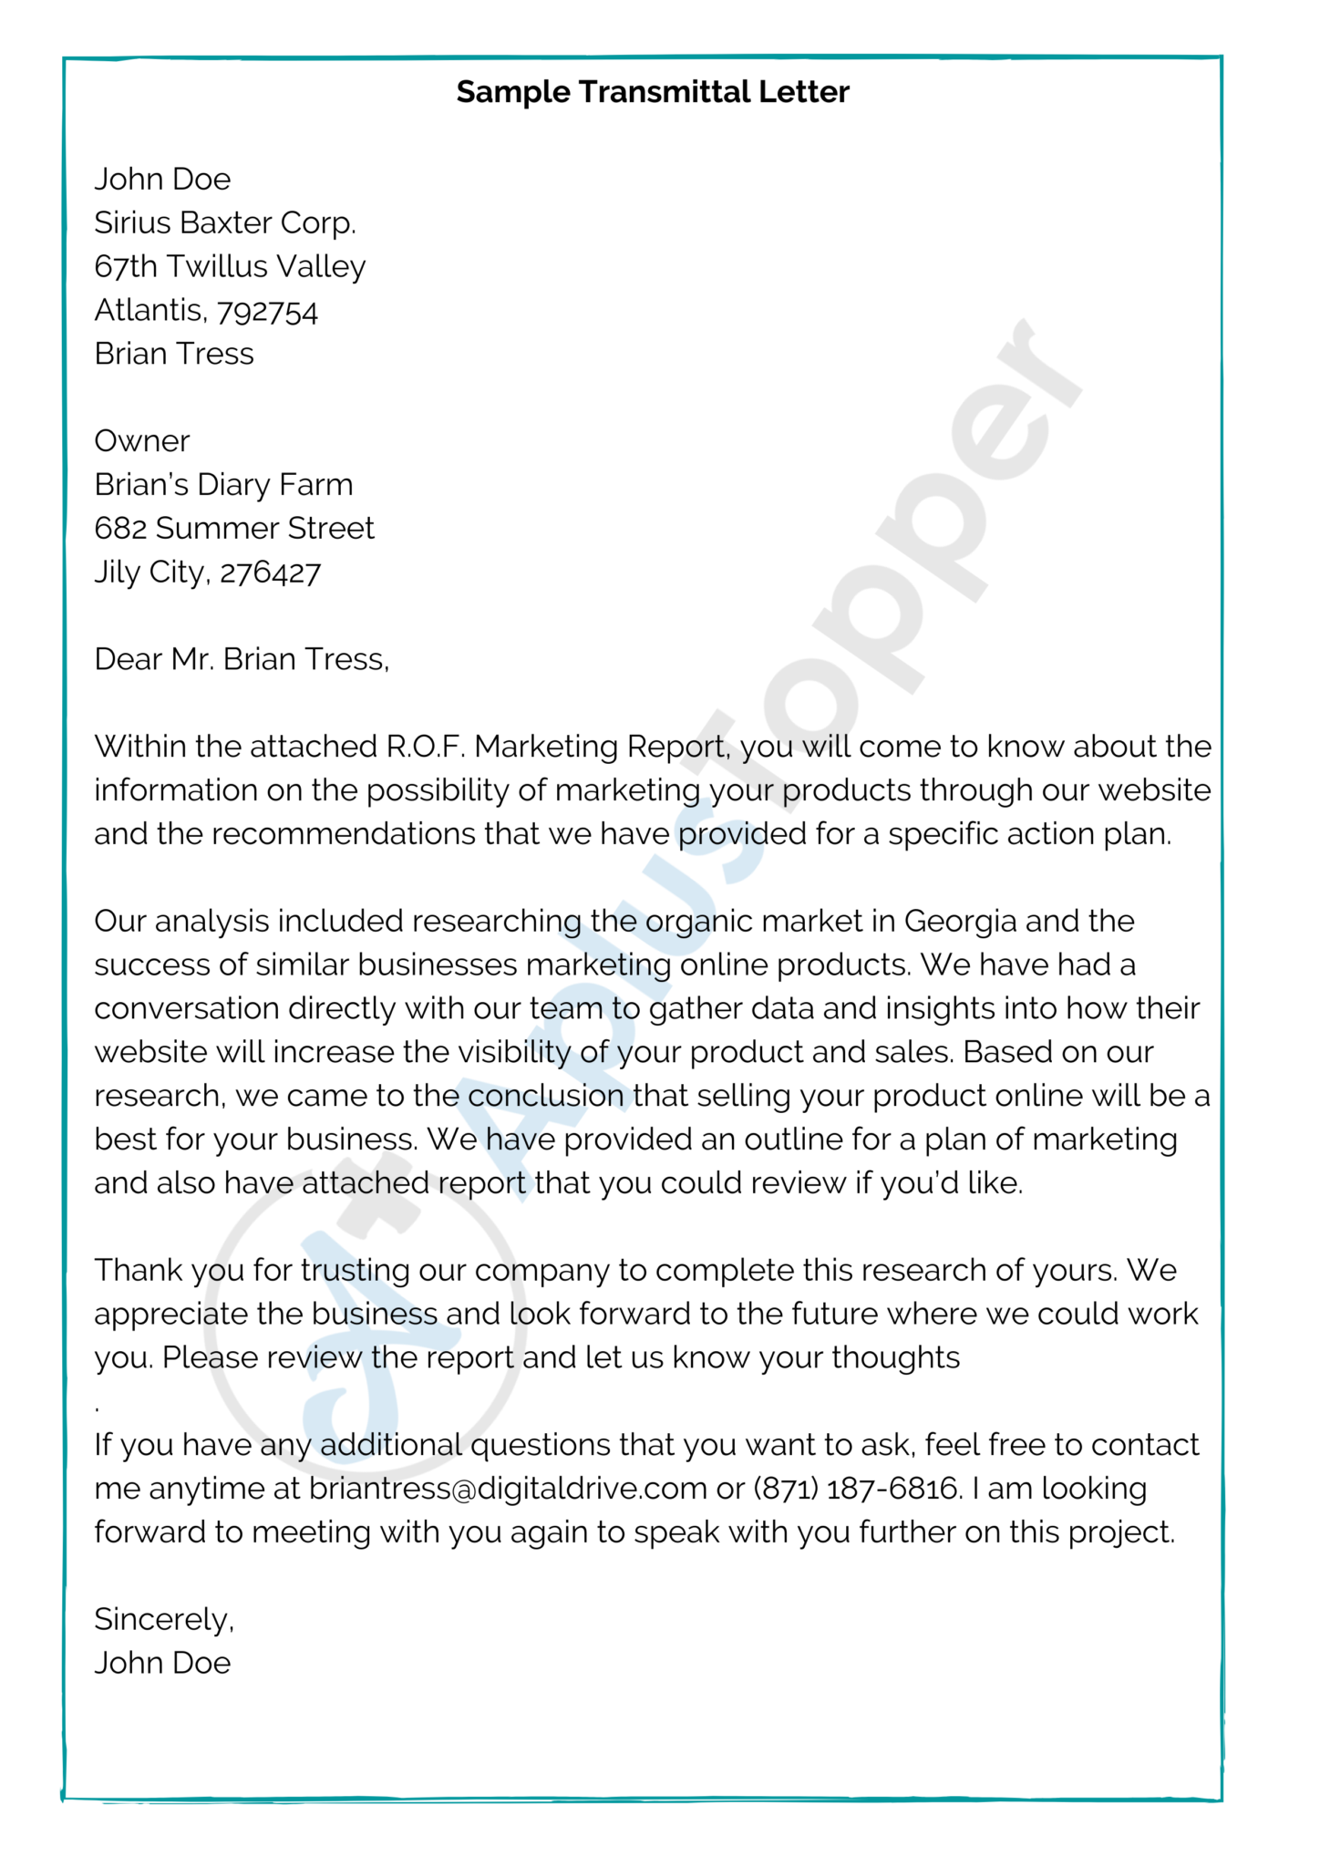
PRACTICAL SESSION:
A letter of transmittal
https://www.aplustopper.com/letter-of-transmittal-samples/

Slide 19
SAMPLE REPORT
The Title:
A REPORT ON THE FIRE OUTBREAK IN THE MAYA CANTEEN PRESENTED TO THE FACILITY MANAGEMENT COMPANY
BY AFIA JOHNSON

Slide 20
SAMPLE REPORT cont’d
Introduction:
This report is prepared at the request of the Facility Management Company on the causes of the recent fire outbreak in the Maya Canteen. It also deals with possible remedies to prevent reoccurrence of such incidents in the canteen.

Slide 21
SAMPLE REPORT cont’d
PROCEDURE/METHOD:
All the members of the canteen staff, leaders of the worker’s Union and the Personnel Manageress were interviewed. A visit was also made to the canteen. Individuals who had vital information towards the realization of the reporter’s objectives were duly invited and their contributions were kept with efficiency, open-mindedness untiring diligence and a high sense of confidentiality.

Slide 22
SAMPLE REPORT cont’d
FINDINGS :
Information gathered during investigations revealed that in the morning of 09th May 2020, there was a worker’s forum to discuss the outcome of requests presented to management for action. This issues included sanitation at the canteen.
On the hearing of her name mentioned at the forum, the bursar telephoned the leaders of the workers and challenged their power to discuss her in public. This infuriated the workers and they attempted to march against the bursar at the canteen. Sensing the danger ahead, she fled from the canteen together with her staff, leaving the cookers still burning. The cookers eventually over-heated and caught fire burning stock of food and furniture there.

Slide 23
SAMPLE REPORT cont’d
Conclusions :
The fire was caused by the negligence and gross disrespect for authority demonstrated by the bursar.

Slide 24
SAMPLE REPORT cont’d
Recommendations:
Based on the findings herein presented, I therefore make the following recommendations:
The bursar should be summarily dismissed and her entitlement used to defray the cost of maintaining the canteen.
2. There should be the formation of canteen committee with representation of workers’ views and interest on it.

Slide 25
LANGUAGE OF REPORT
Writing Style
Avoid colloquial or informal language, and eliminate all fillers and needless words.
Avoid ambiguous, imprecise or vague words such as various, some, particular, numerous, etc. Try to avoid impersonal expressions. Be clear, concrete, specific, precise and direct.
Do not use ‘wordy’ expression either.
Organize the text in paragraphs and ensure that the paragraphs are more or less evenly distributed
Be consistent in tense use throughout paragraphs
Use transitions between paragraphs to maintain coherence
Abbreviations and contractions
Limit the use of abbreviations. Always explain the abbreviations you are using.
Avoid contractions such as doesn’t, haven’t, can’t, etc. Always write full forms.

Slide 26
REFERENCES
Adolinama, P. P. (2005). Communication Skills for University Students. Accra: ANEST Company Limited.
Lunenburg, F. C. (2010). Communication: The Process, Barriers, And Improving Effectiveness. Schooling Vol.1(1), pp.1-11.
(url:http://www.nationalforum.com/Electronic%20Journal%20Volumes/Lunenburg,%20Fred%20C,%20Communication%20Schooling%20V1%20N1%202010.pdf)
Sekyi-Baidoo, Y. (2003). Learning and communicating (2nd Ed.). Accra: Infinity Graphics Ltd.
www.aplustopper.com: https://www.aplustopper.com/letter-of-transmittal-samples/
www.lettersandtemplates.com: http://www.lettersandtemplates.com/simple-authorization-letter-sample

